Slide 1
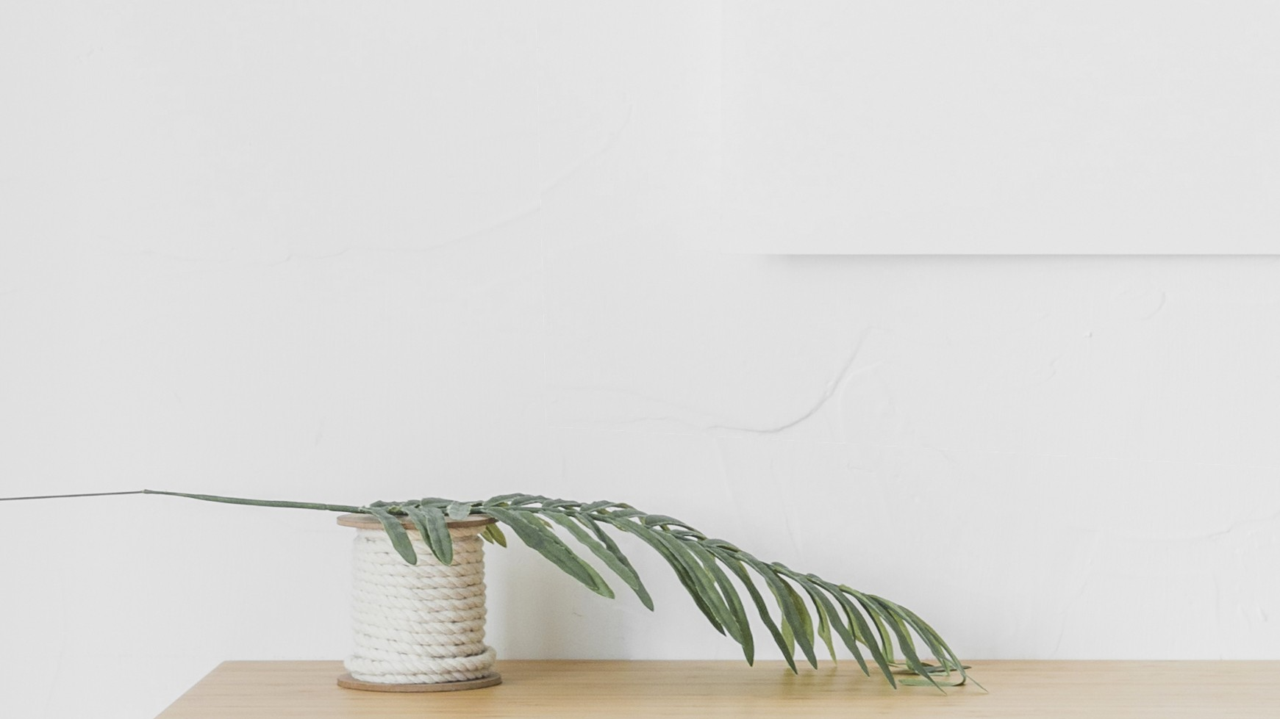
HELLO
GROVEMADE!
Web Design & Accessibility Review
CS130 Homework1
Jiayang Liao

Slide 2
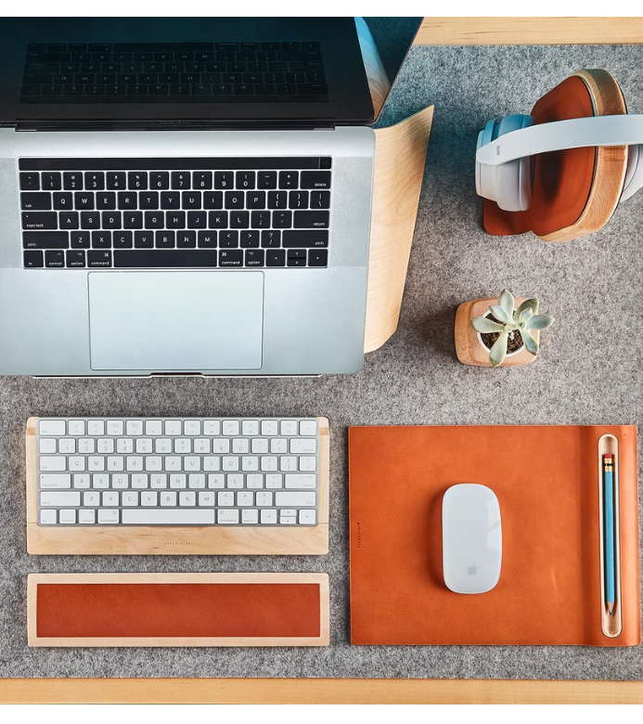
TABLE OF CONTENTS
01
Composition Analysis
02
Accessibility Analysis
03
Fun Facts
Examples and answers to
6 questions listed as requirements
Accessibility check,
Ideas for improvements, and
Comparable websites.
Fun facts discovered during exploration

Slide 3
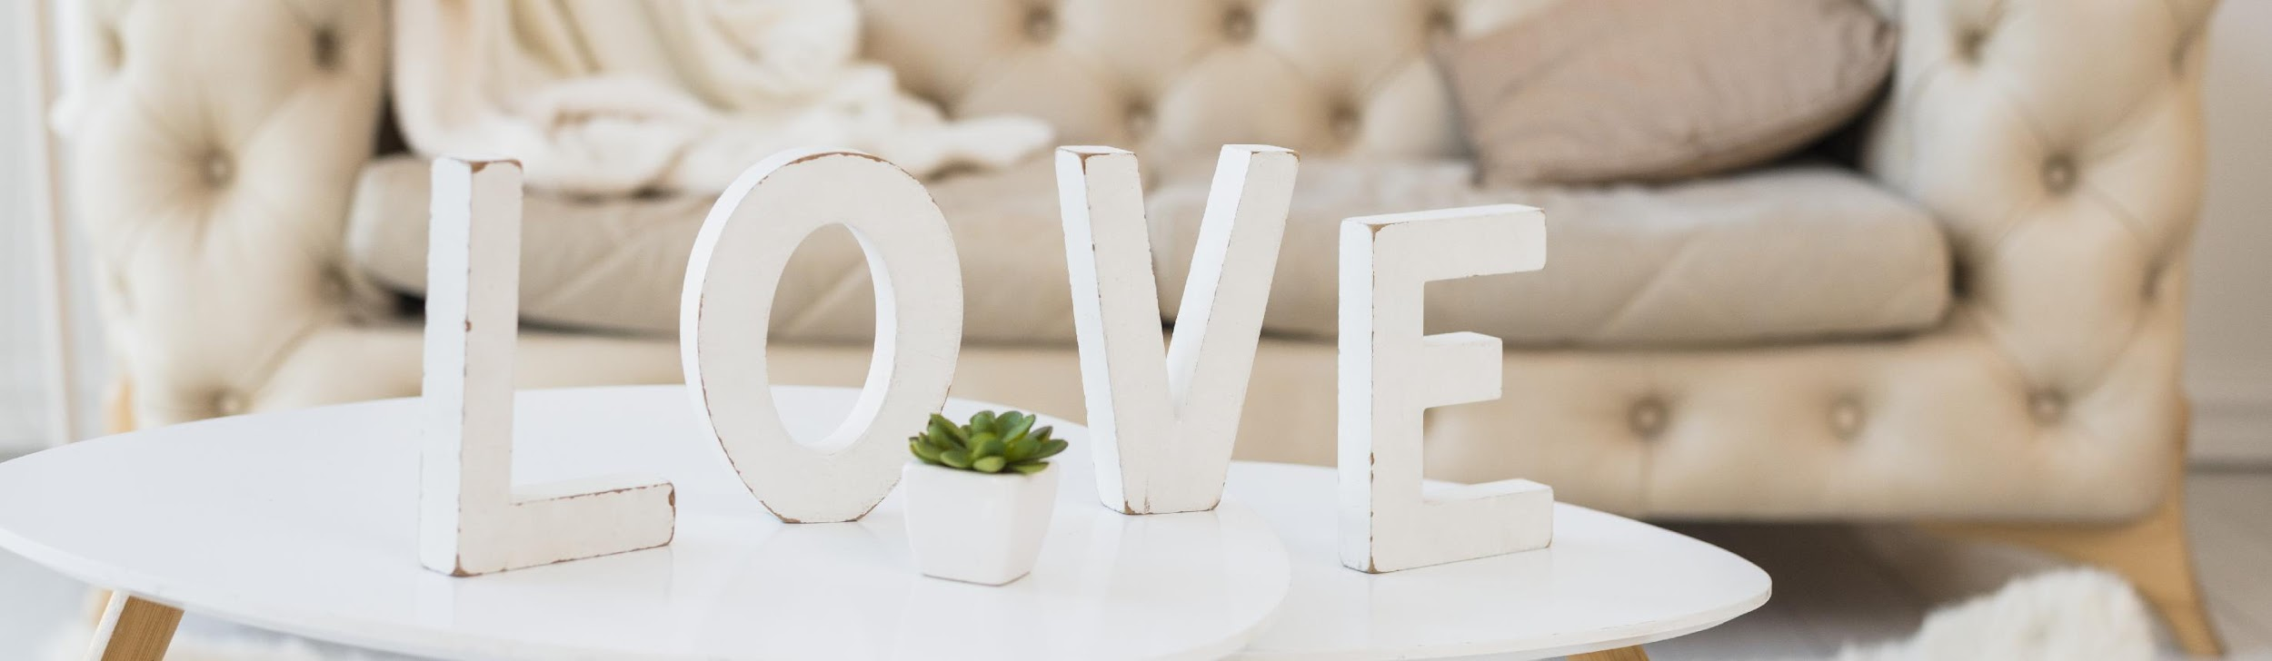
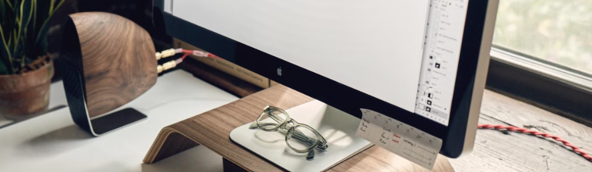
Composition Analysis
Principle of composition:
Contrast, Repetition, Alignment, Proximity

Slide 4
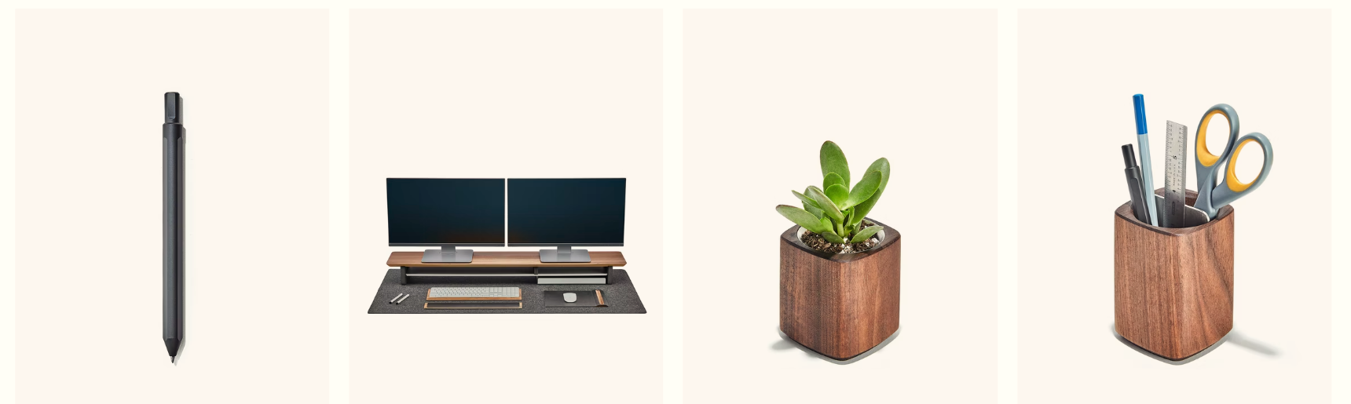
GROVEMADE
A design company for
minimalist working space.
It always inspires me by its
simple but creative designs.

Slide 5
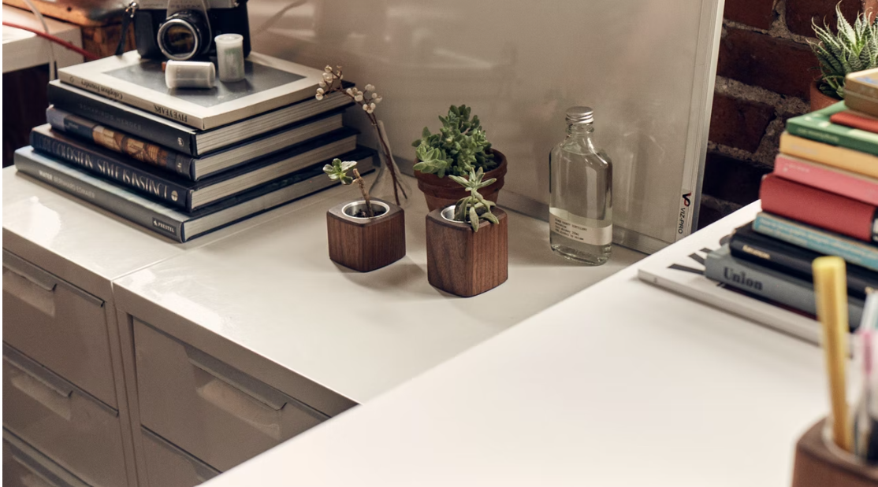
WHAT VALUES DOES IT COMMUNICATES?
Minimalism
Creative
Joyful

Slide 6
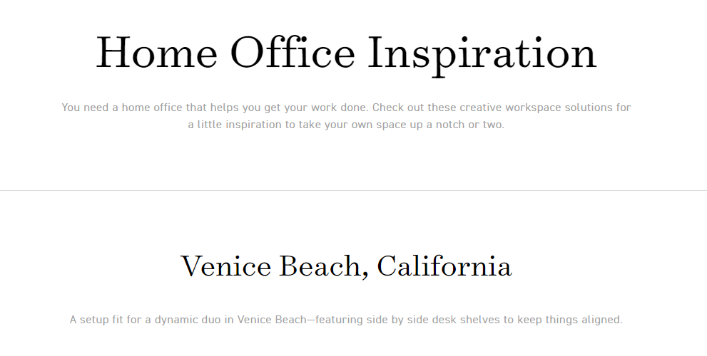
How does the design help to communicate these priorities?
Contrast
White background,
with colorful pictures
(i.e., next page)
Repetition
Consistent styles of pictures
Proximity
Large margin and good alignment to group to contents and improve reading experience
Alignment

Slide 7
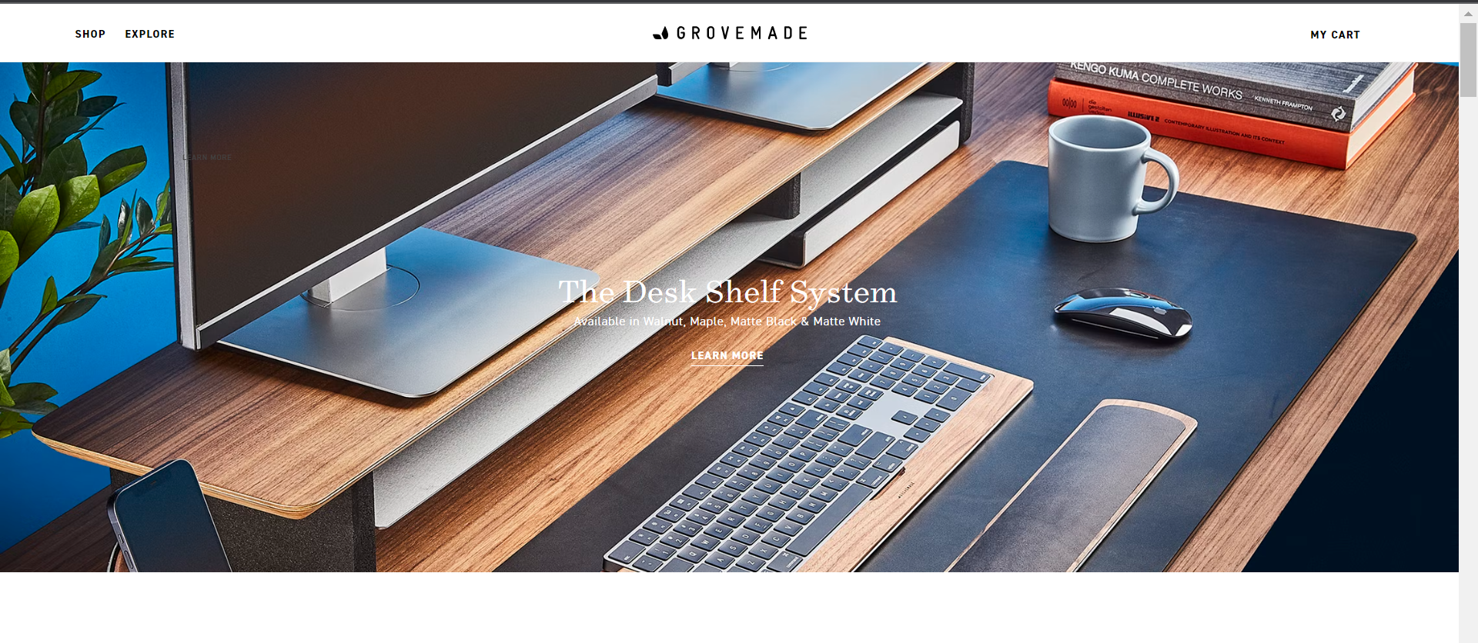
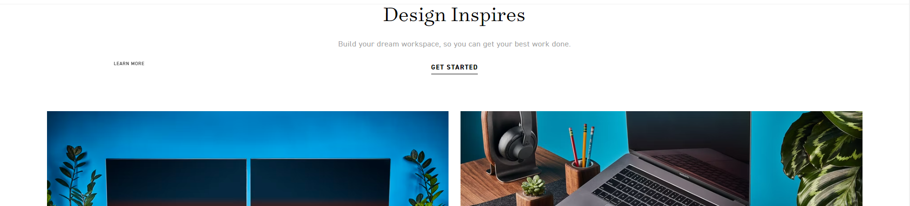
“Appropriate usage of contrast, attracting reader’s attention to pictures without being messy.”

Slide 8
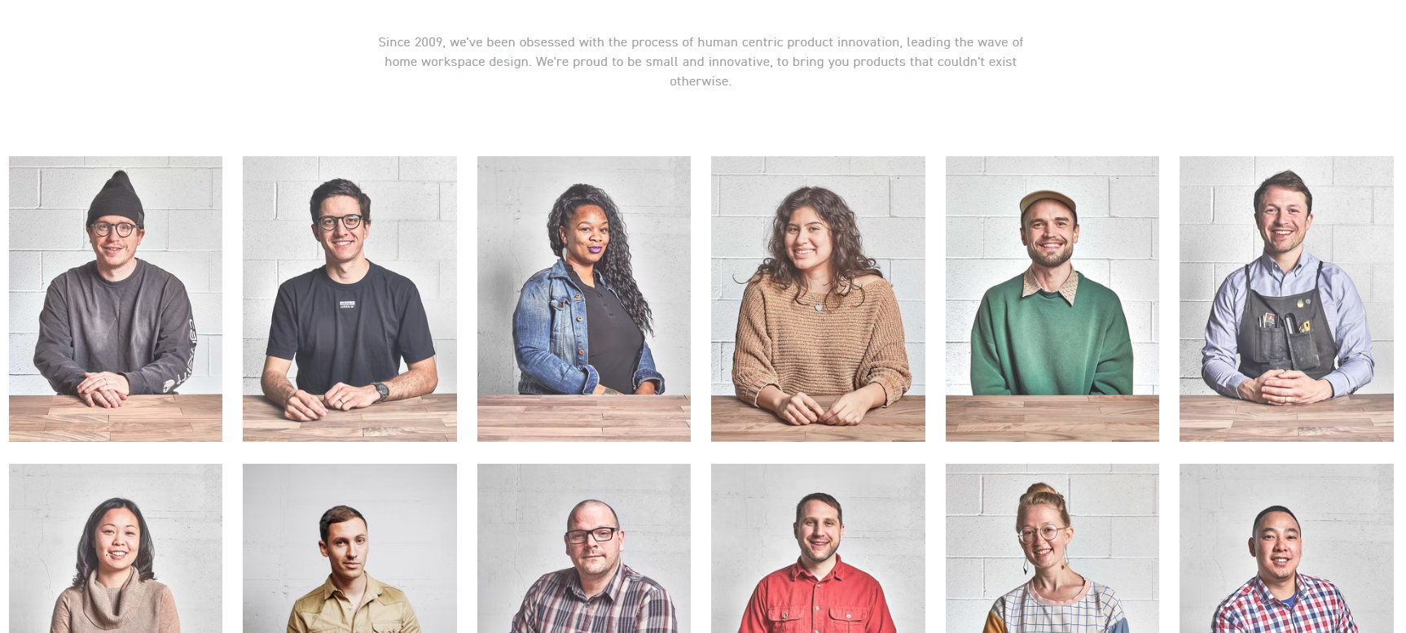
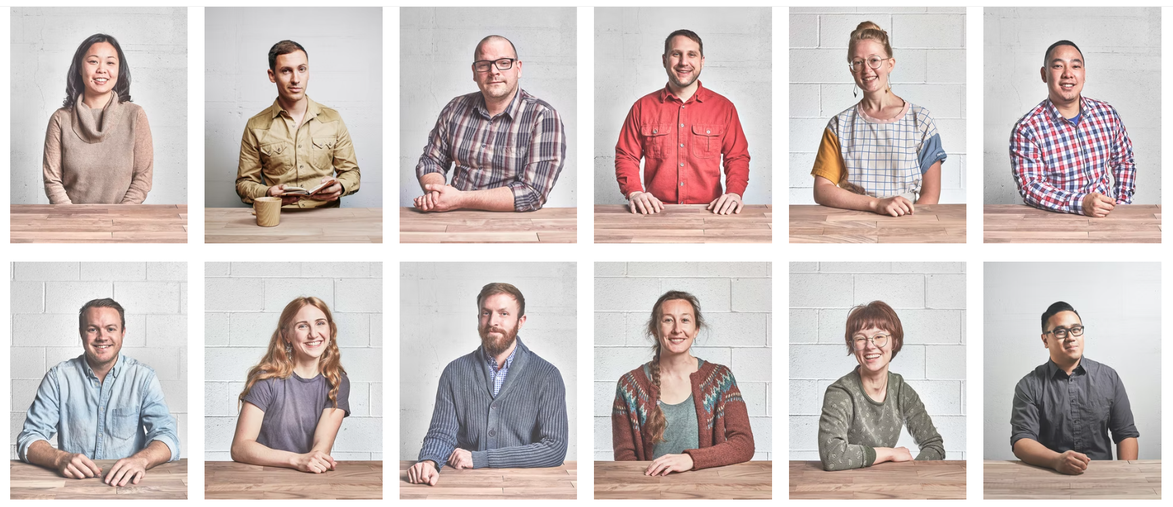
Creative & Joyful! Clear background with colorful clothes and joyful faces

Slide 9
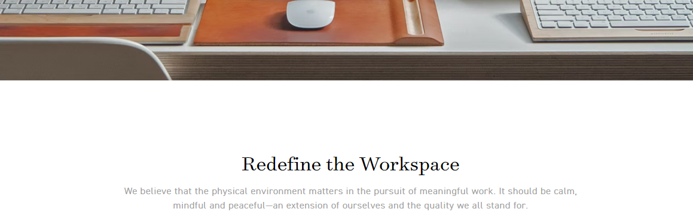
Text is the least important here
Text
All text in this site is light in both font and color.

Slide 10

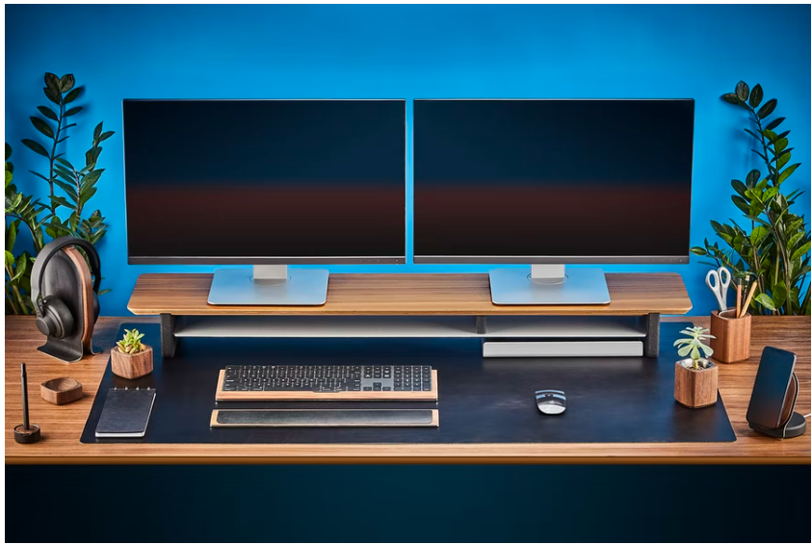
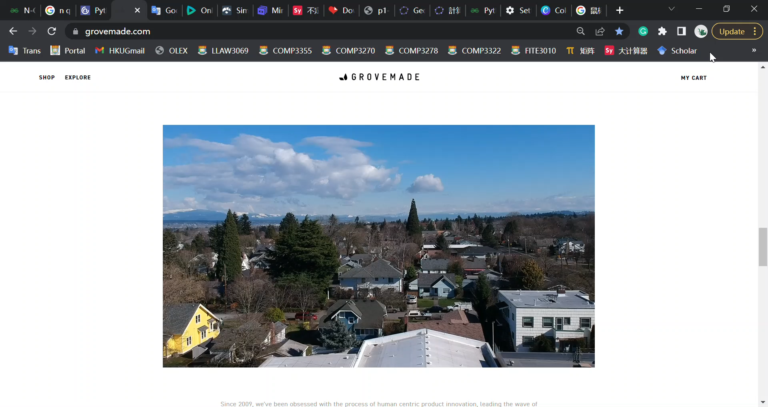
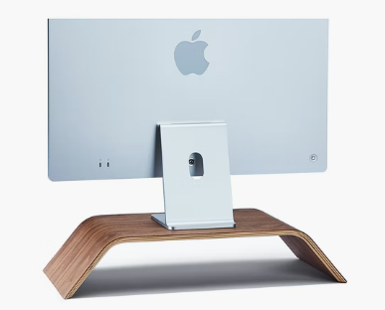
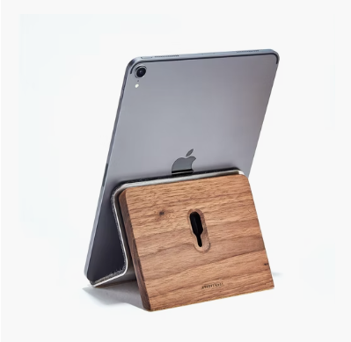
Strengths Of Site Design
Complementary color
Use complementary color palette to make webpage clean and have highlights
Hyperlinks Everywhere
Videos
Auto-playing videos
make the site more attractive and live
All pictures are embedded with hyperlinks to improve accessibility
Branding
Consistency in homepage and company’s image
Co-branding with Apple
—similar design language

Slide 11
What Is The Limitations Of Site Design?
Limitations
Lack of text:
Information is hidden in different hyperlinks.
Artistic language expression:
A bit hard for users to grab the key information.
No alternative tags when image is unable to display.

Slide 12
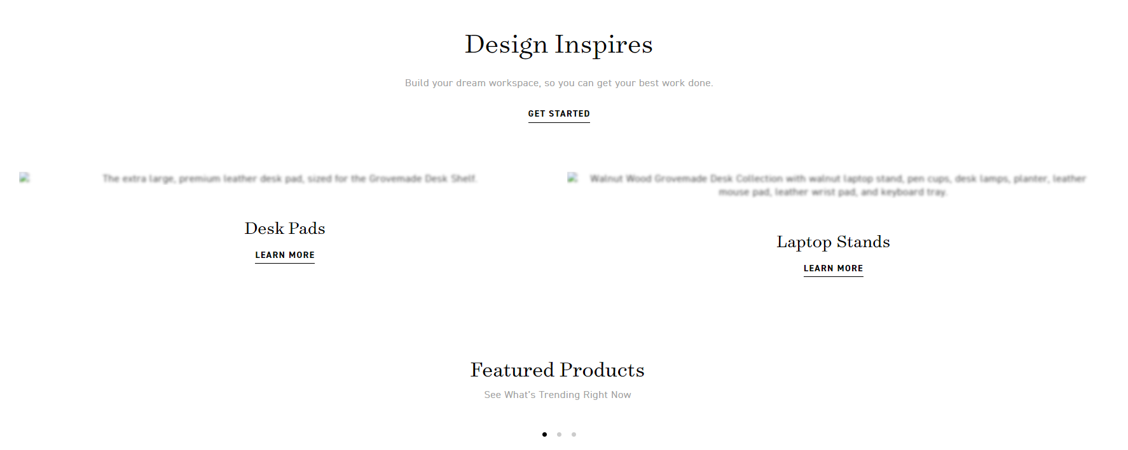
Example: blurred text when image is broken

Slide 13
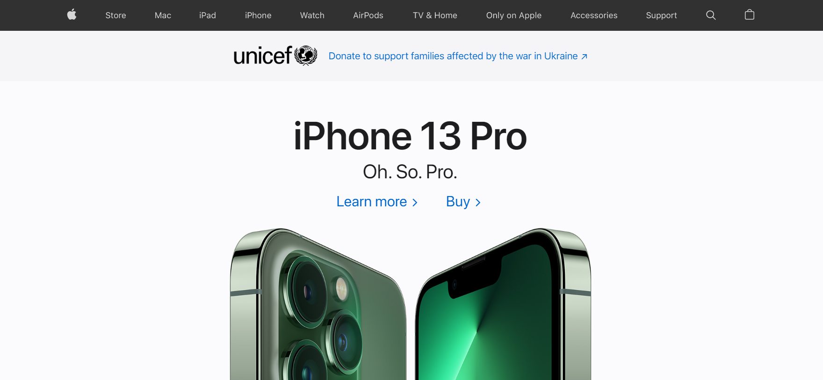
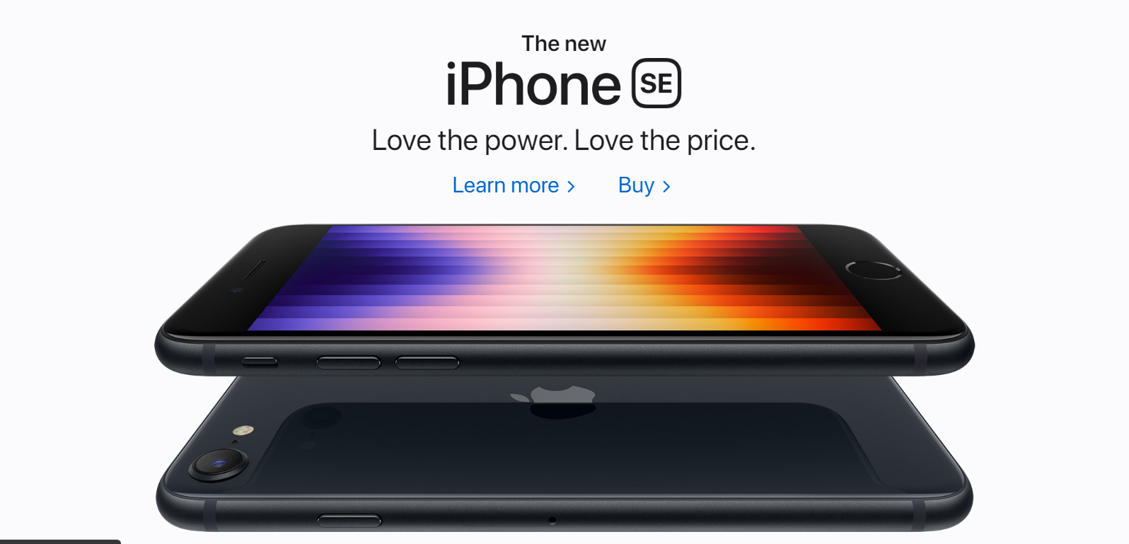
Apple
Comparable Site
Similar design language:
Minimalism with creativity
Better job:
Straight-forward text &
Appropriate emphasis
Notes:
Comparable site
Co-brander: apple
Similar design language
Minimalism with creativity
But apple does a better job.
Straight-forward text &
Appropriate emphasis
That’s all for the composition analysis. Then let’s move to accessibility analysis.

Slide 14
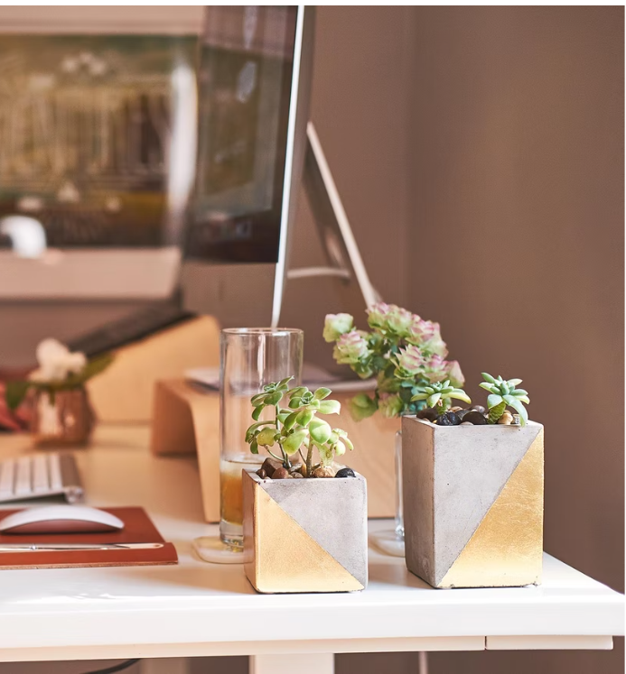
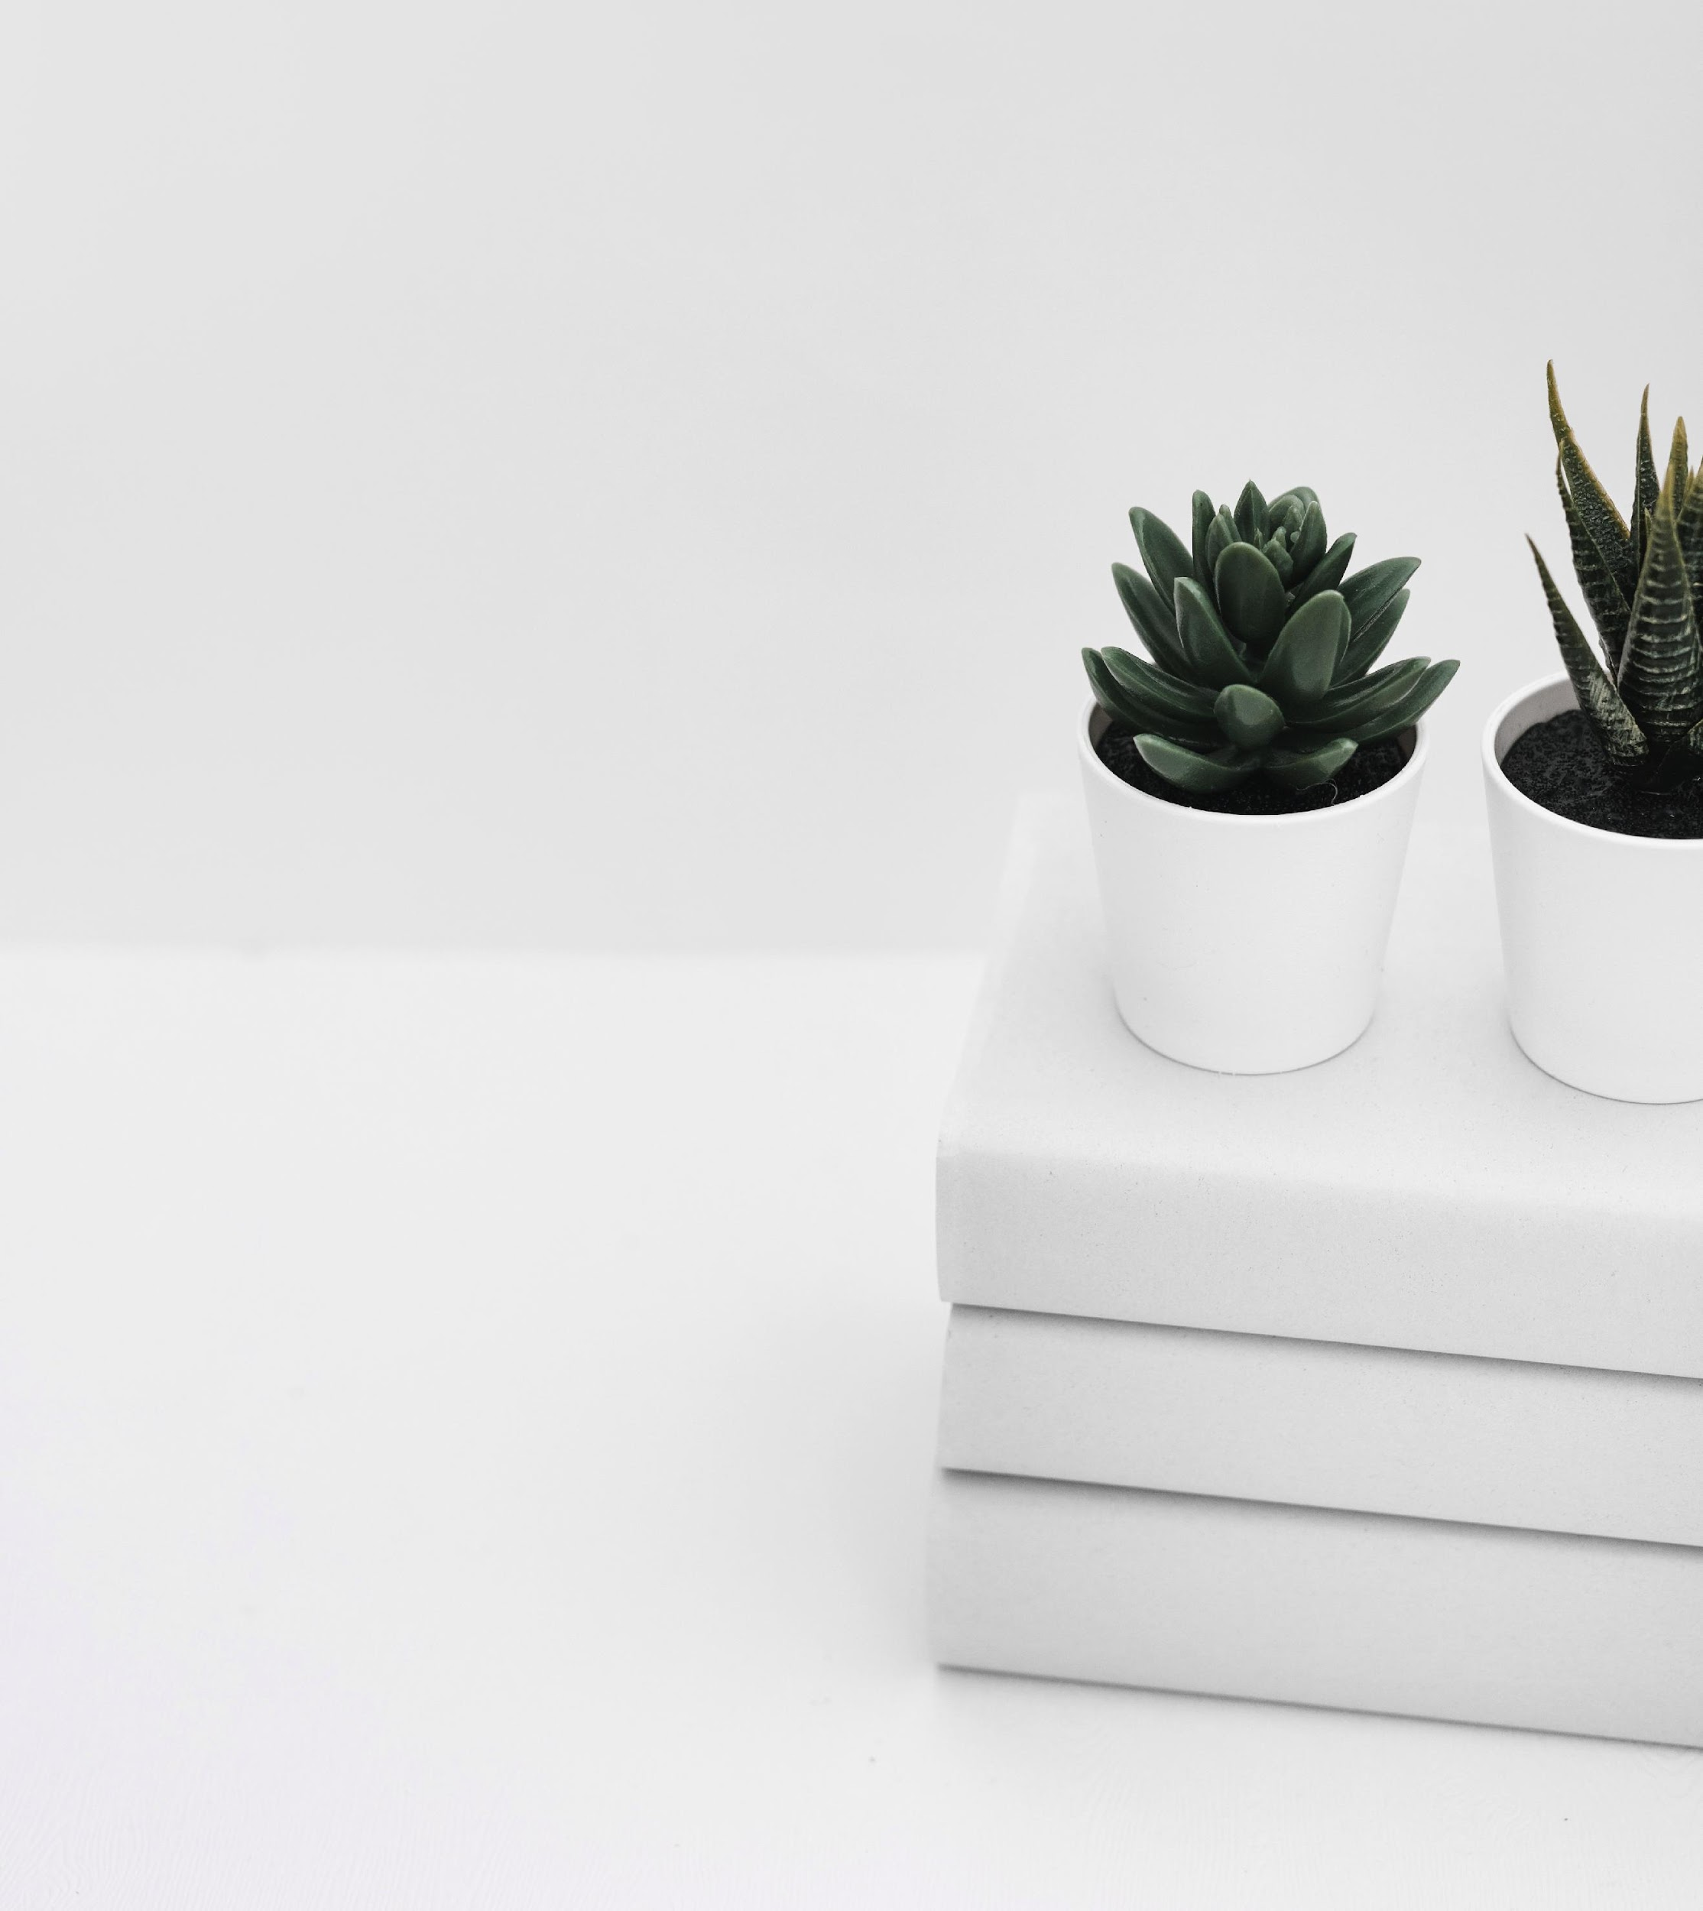
02
Accessibility Analysis
Properties of a good web design
Balance, Contrast, Emphasis, Proportion
Accessibility beyond looks
Notes:
Based on Victoria’s lecture,
4 properties of a good web design
And we also have accessibility beyond looks.

Slide 15
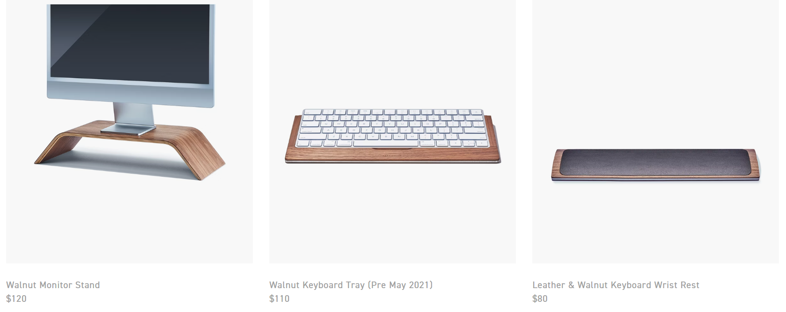
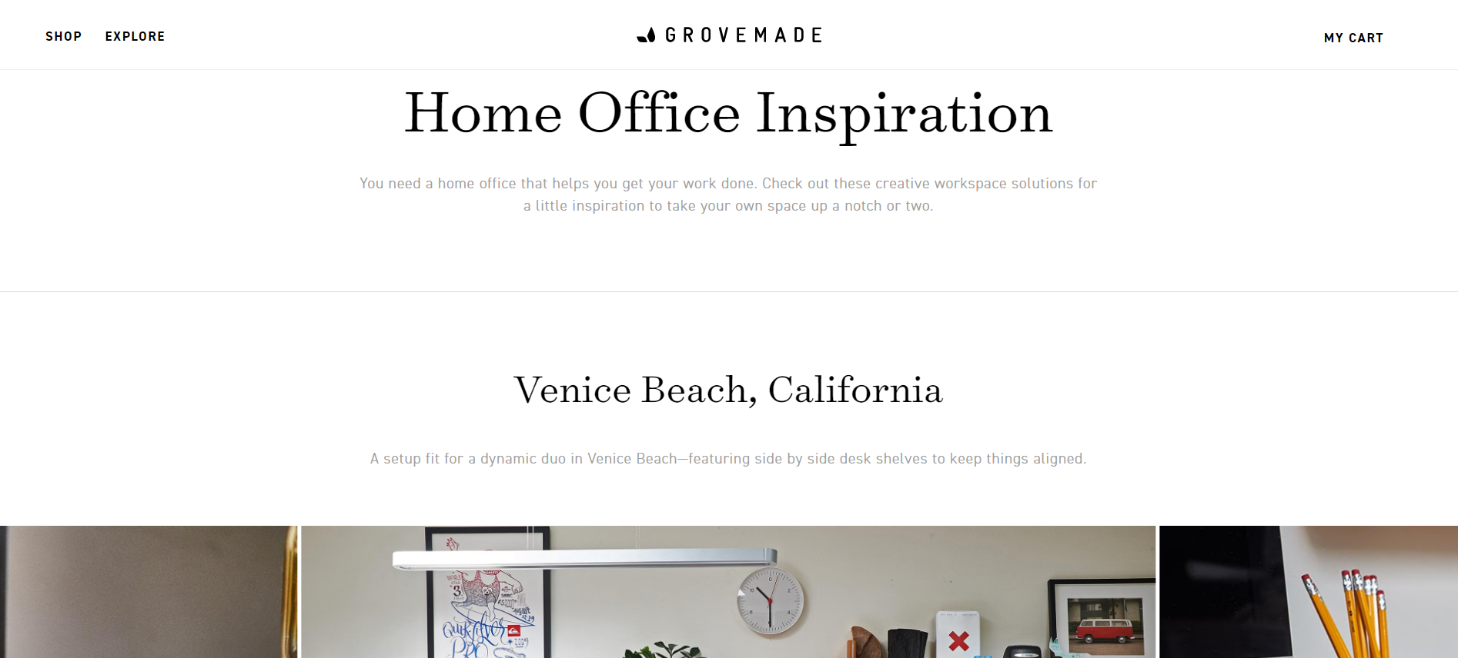
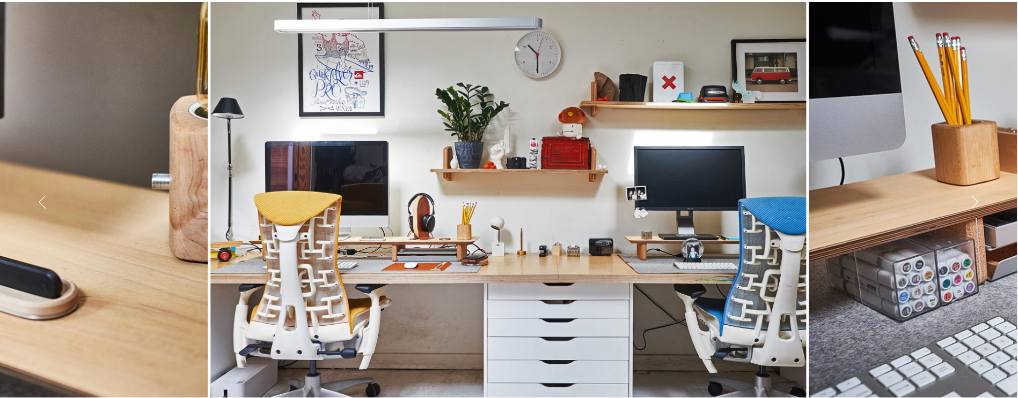
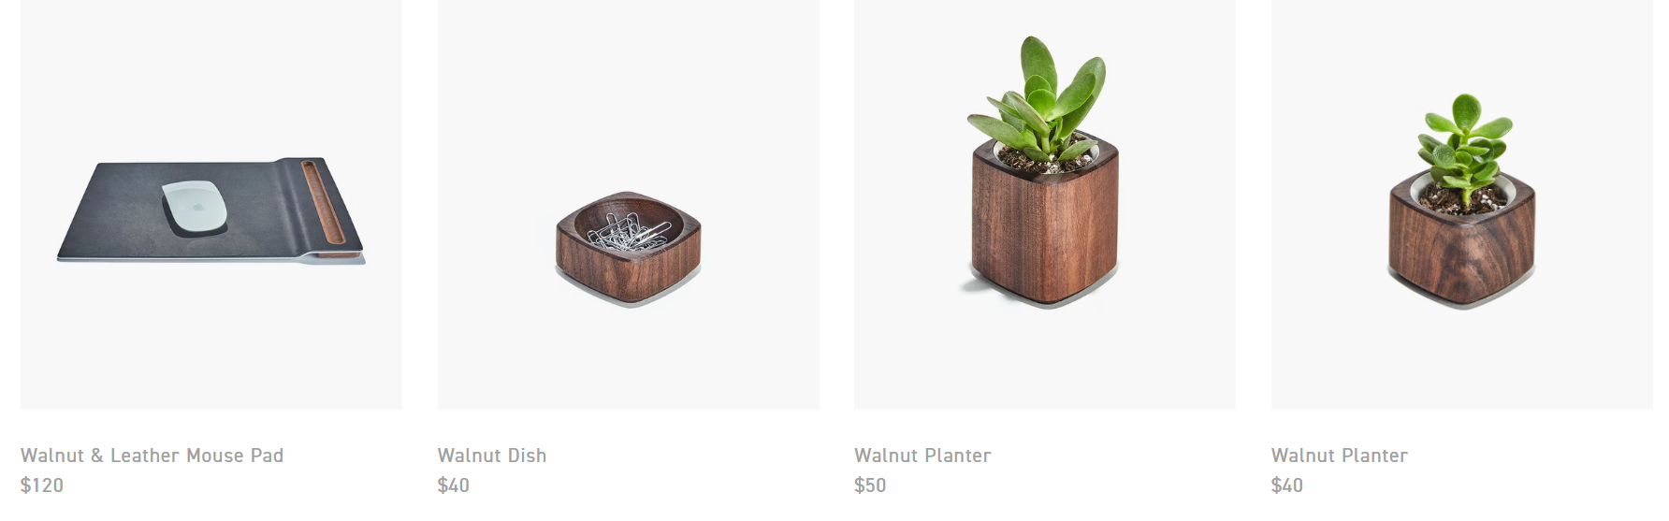
Accessibility Analysis –Balance
Symmetrical design
Appropriate size of images and text
Notes:
2 points
Symmetrical
Appropriate size: image size consistent with item size.
- Monitor stand is larger than a mouse pad here, and so do the images show.

Slide 16

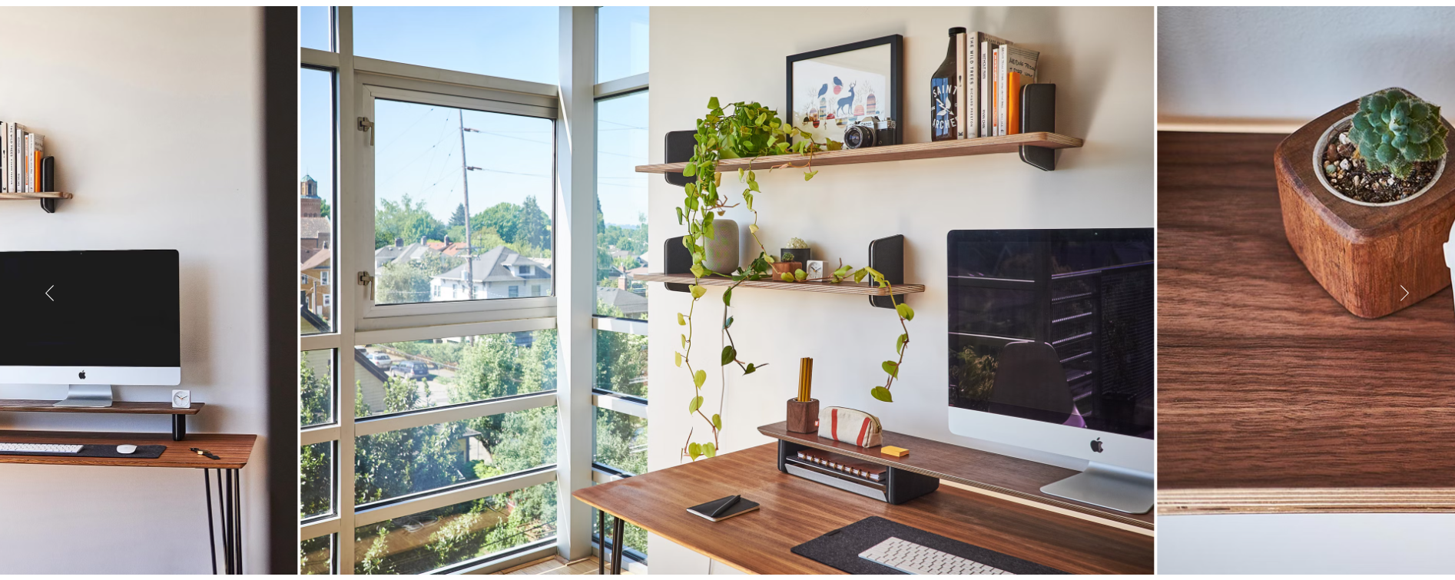
Accessibility Analysis –Contrast & Emphasis
There’re TWO level of contrasting emphasis relationships in site:
Large & dark title vs. Small & light body paragraph
Clean & concise background vs. Colorful design scenarios
Examples are as follows:

Slide 17
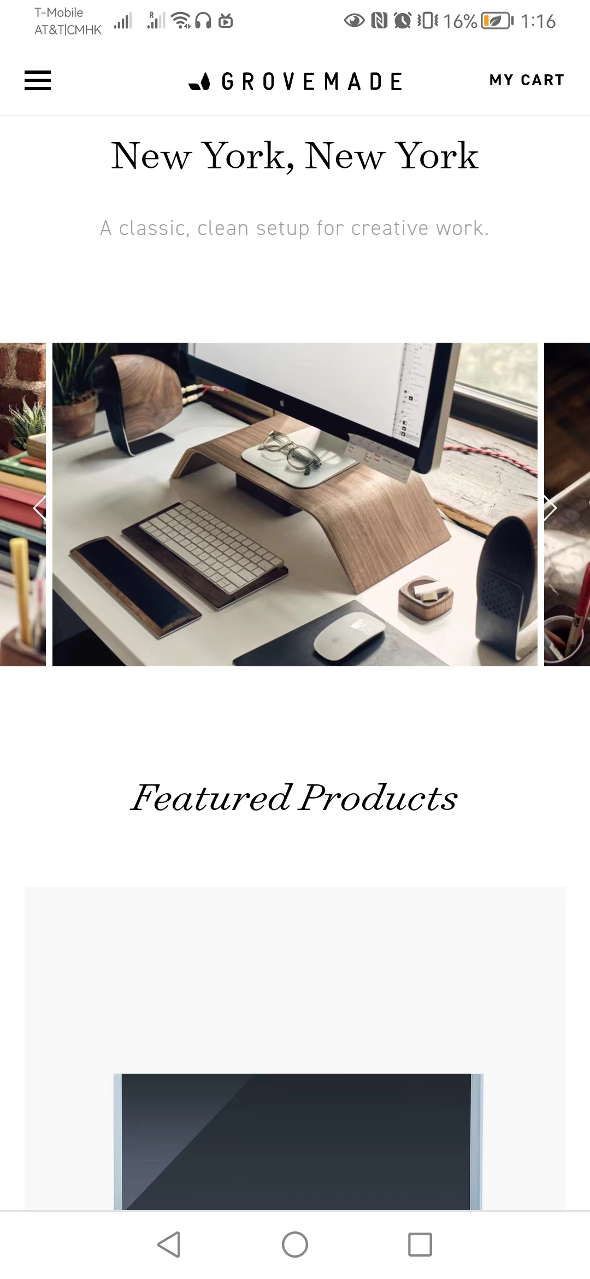
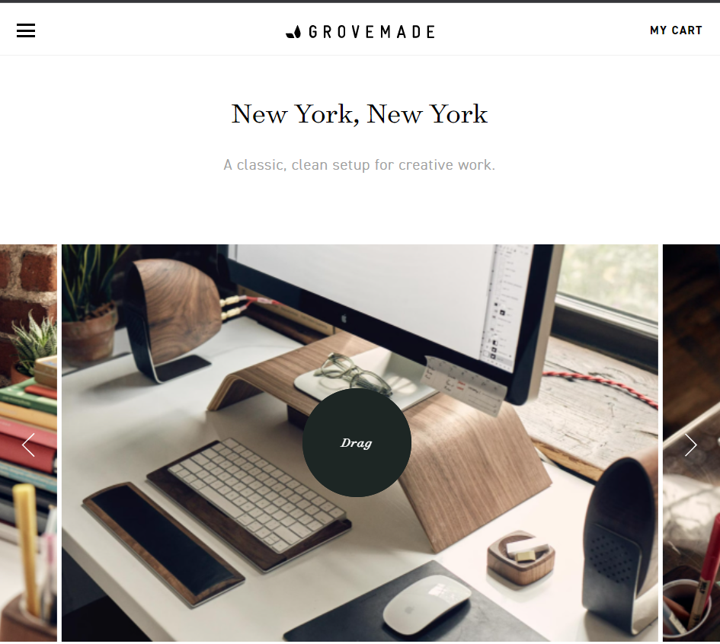
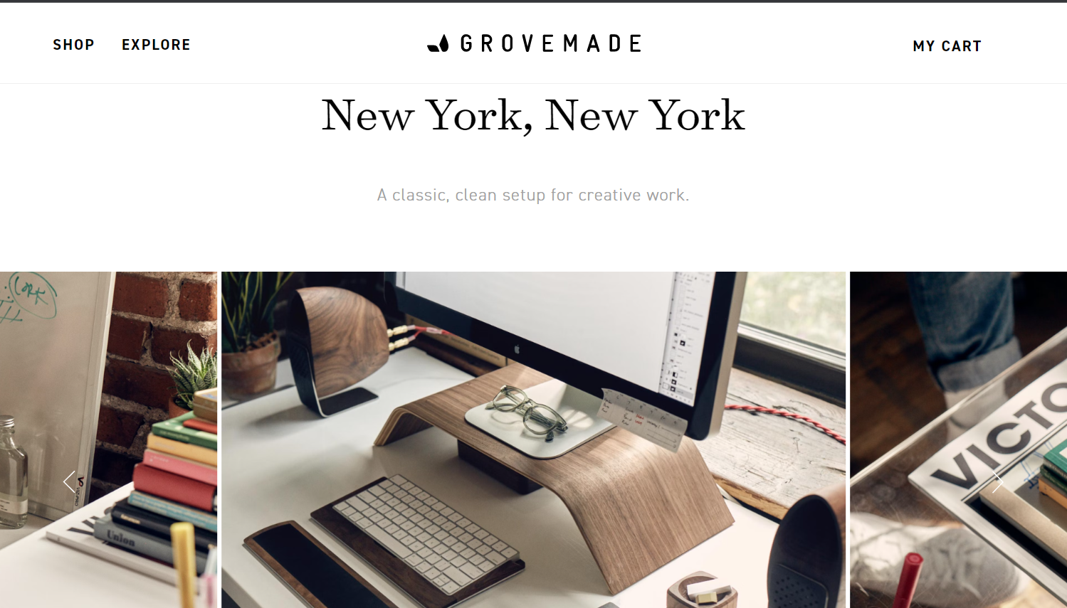
Accessibility Analysis –Proportion
Auto-resize according to browser width (Interoperability to multi-devices!)
In full-screen, the size of image is too large to view it without scrolling up and down. (disadvantage)
Examples are as follows (different margins between text):
Cell phone screen
50%-width PC screen
100%-width PC screen
Notes:
Referring to proportion, I immediately think about resizing discussed in our last lecture.
By auto-resizing, the image won’t be distorted. And there’re different margins between texts under different width.
It also has a good performance on my cell phone.

Slide 18
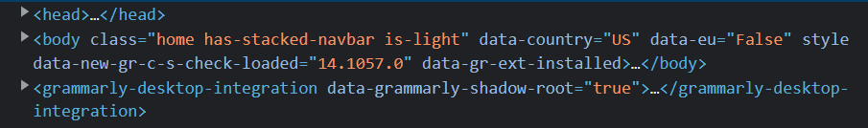
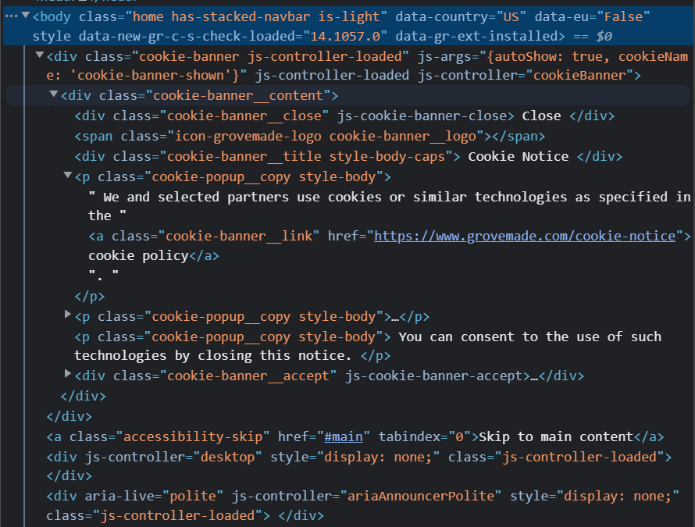
Accessibility Beyond Looks –Semantic HTML
Some semantic elements is used is webpage design
Use different class names to navigate between same semantic elements, better code readability.
Embedded “accessibility skip” to main tag (I was unaware of the embedding until looking at the code!)
Notes:
Then let’s talk about accessibility beyond looks.
Semantic, head, body, these semantic elements
Expand one of the divisions under body tag.
Different class name
Found surprisingly when looking at code.

Slide 19
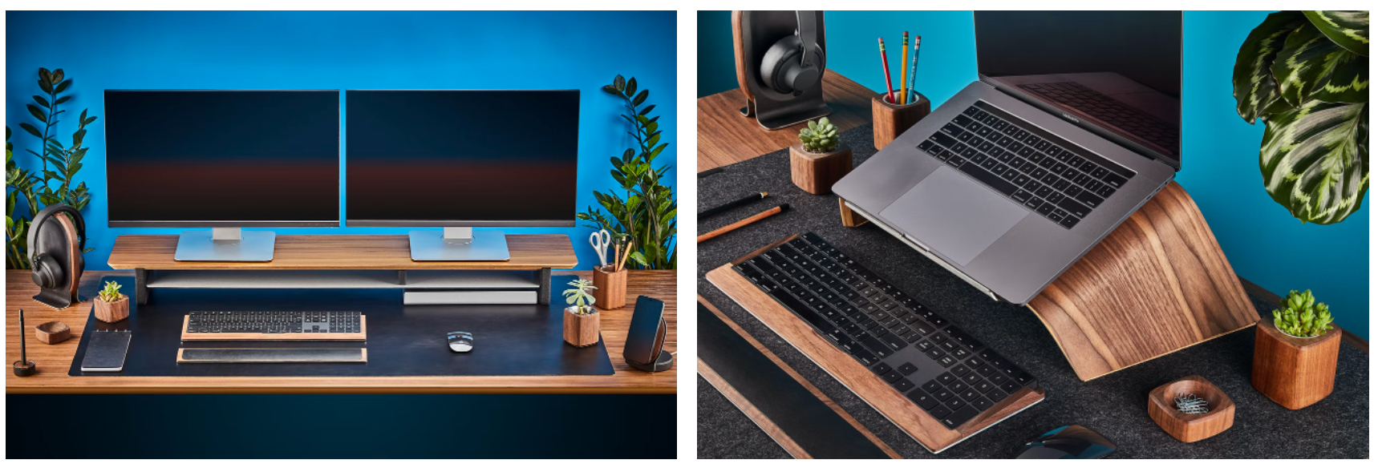
Improve Accessibility Example: use notations when image is broken

Slide 20
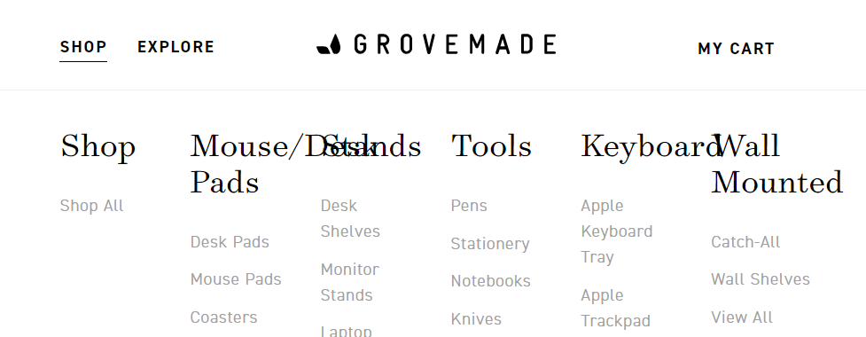
Ideas To Improve Accessibility
Arrange text & pictures by percentage:
Overlap when browser width being narrowed.
Live chat for customer service
In an online shop, Robo-chat or live chat will help to improve user accessibility and experience a lot.
Add notations for images or video with sound:
Friendly to sight disabilities and image display error.
Notes:
Other ideas to improve accessibility.
When narrow down the browser, some text is overlapped. → rearrange

Slide 21
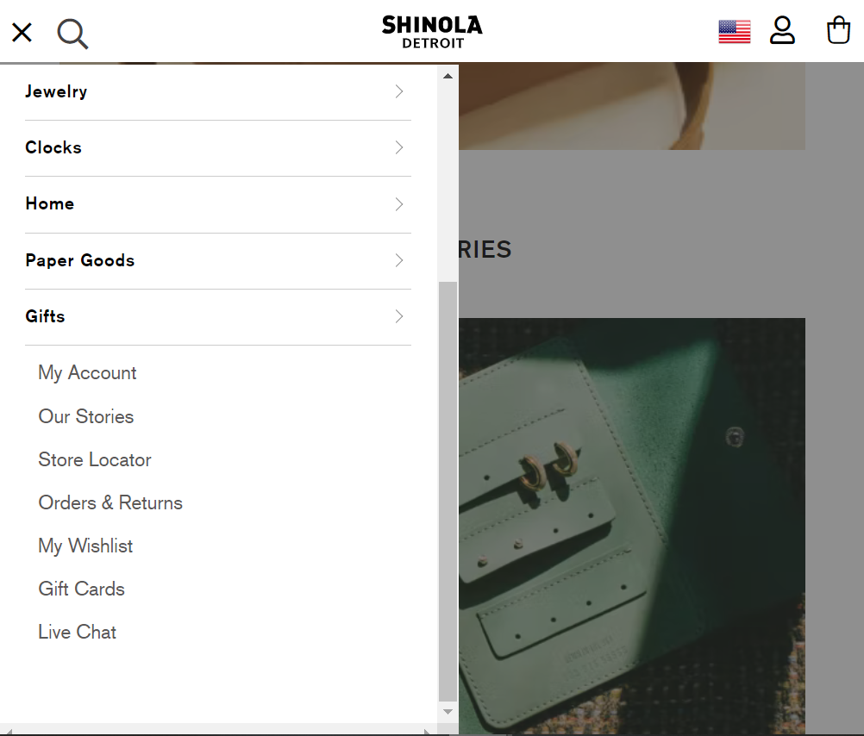
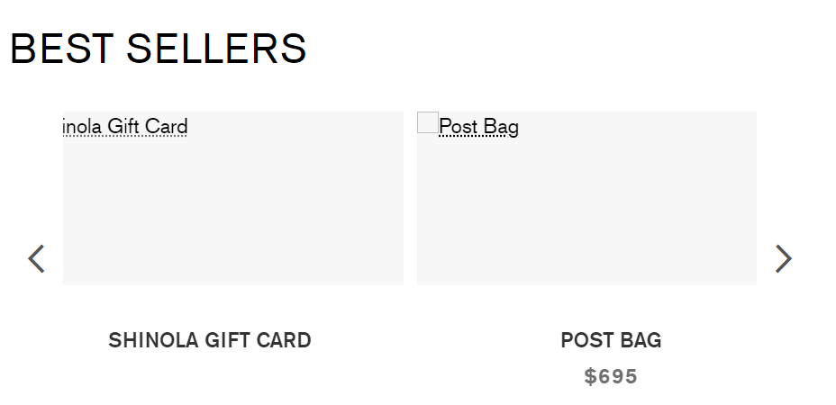
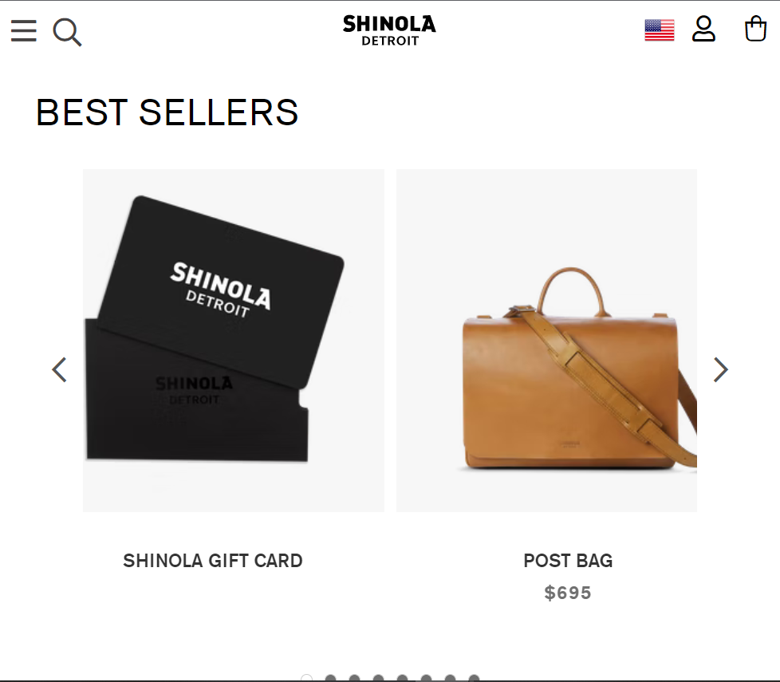
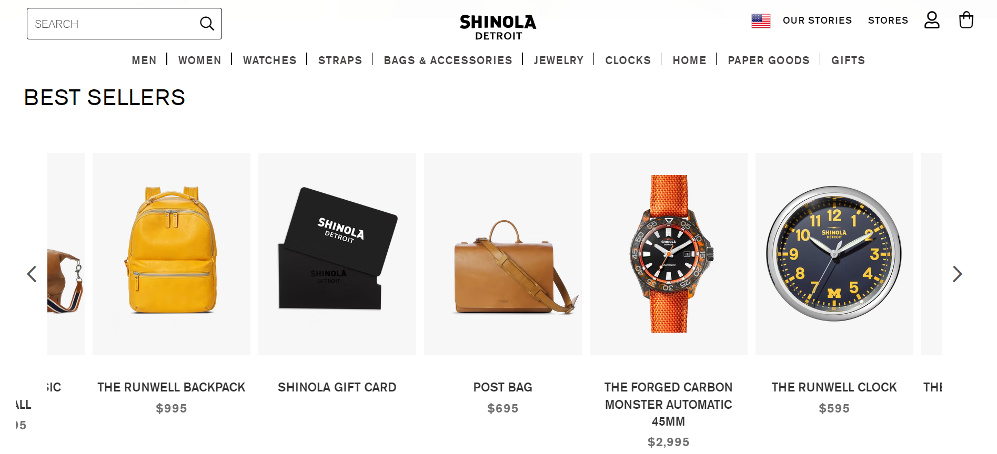
Shinola
Comparable Site
Tags for broken images
Offer Live Chat
Clear tags for broken images
No overlapping when resizing:
Hide Horizontal text in bars,
No overlapping
Notes:
Shinola, similar design language, minimalism & creativity
It also has an online shop.
Let’s see what improvements it offers comparing to Grovemade.
Live chat: critical of websites having online shopping functions.

Slide 22
Fun Facts!
https://grovemade.com/
Notes:
That’s all for the accessibility analysis. And I’d like to share some fun facts during my exploration.

Slide 23
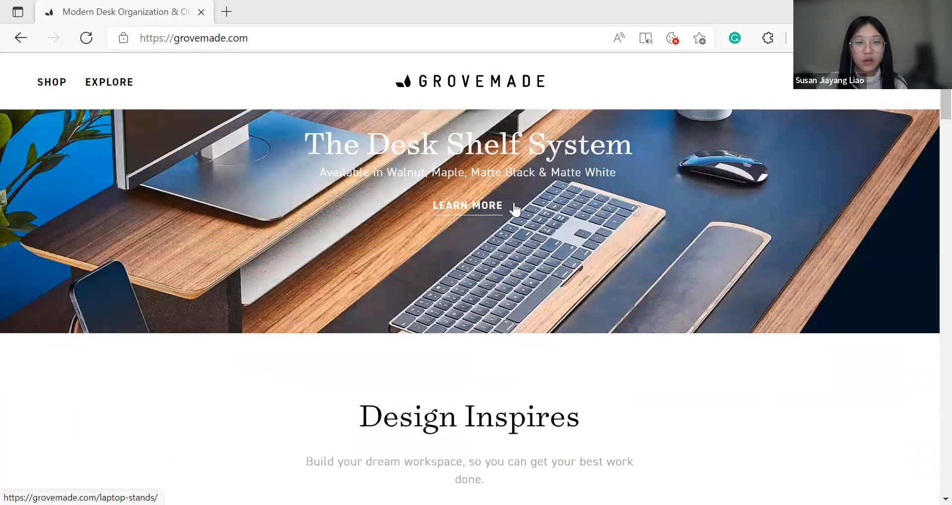

Slide 24
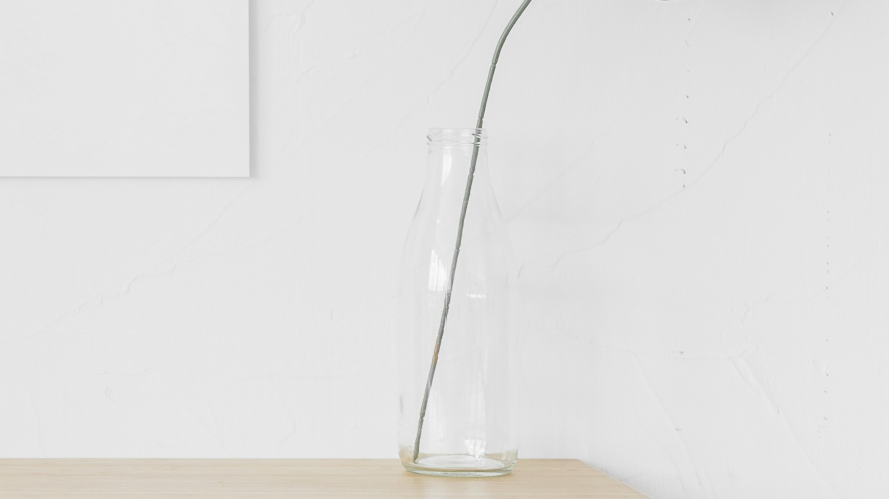
THANKS!
CS130 Homework 1:
Web Design & Accessibility Review
Jiayang Liao UID: 3405013

